Slide 1
Python Sequences
&
Python Operators

Slide 2
1 Python Sequences

Slide 3

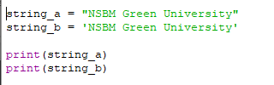

Applications of single quotes & double quotes

Slide 4
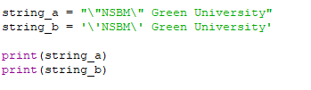

Invalid Syntax

Slide 5
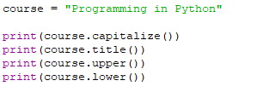
Changing Character Cases…
capitalize() – Capitalize the first letter of the statement/sentence
title() – Capitalize each first letter of words in the statement
upper() – Capitalize each letter
lower() – Maintain each letter in lower case

Slide 6
2 Python Operators

Slide 7
Overview…
Operators are used to perform operations on variables and values.
Python language supports the following types of operators
Arithmetic Operators
Assignment Operators
Comparison (Relational) operators
Logical Operators
Bitwise Operators

Slide 8
“
Arithmetic Operators

Slide 9
Like most languages, Python consists of terms joined together by operators.
The operators include the conventional ones from arithmetic along with a few that are somewhat less familiar.
Addition
- Subtraction
* Multiplication
/ Division
% Modulus
// Floor Division
** Exponentiation
+

Slide 10
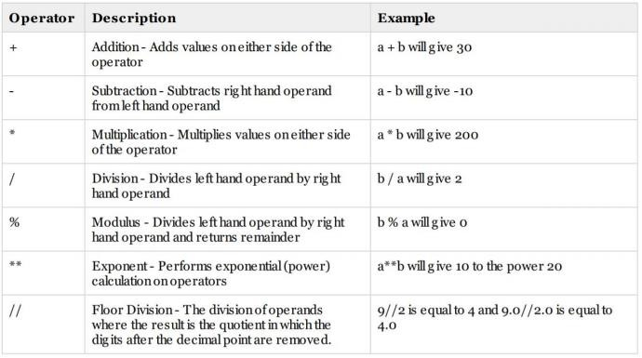
Assume that, a = 10 , b = 20

Slide 11
“
Assignment Operators

Slide 12
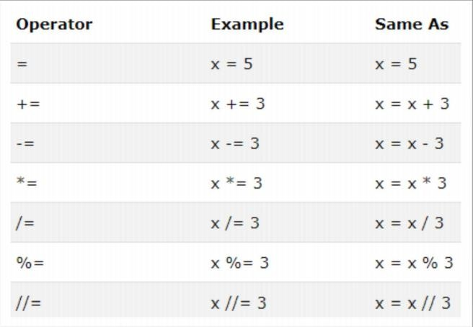


Slide 13
“
Comparison Operators

Slide 14
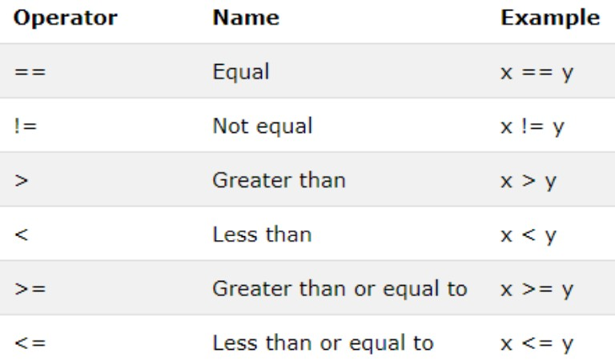

Slide 15
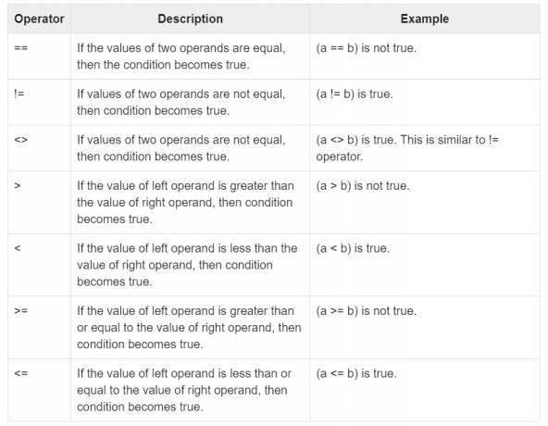
Assume that a = 10 , b = 20

Slide 16
“
Logical Operators

Slide 17
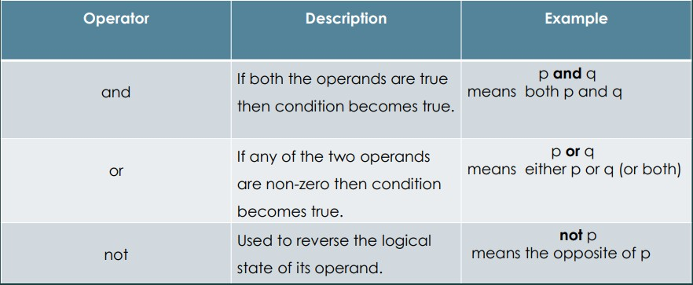

Slide 18
Task 01

Slide 19
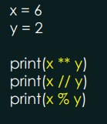



Determine the output of following code snippets.
“

Slide 20



Determine the output of following code snippets.
“

Slide 21
“
Bitwise Operators

Slide 22
Used to perform bitwise calculations on integers.
The integers are first converted into Binary and then operators are performed on bit by bit, hence the name bitwise operators.
Then the result is returned in Decimal format.

Slide 23
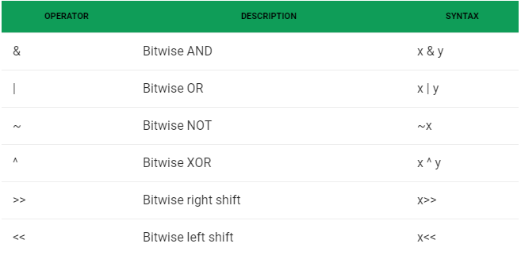

Slide 24
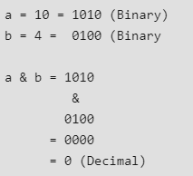
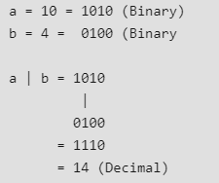
a & b - Returns 1 if both the bits are 1 else 0
a | b - Returns 1 if either of the bit is 1 else 0

Slide 25
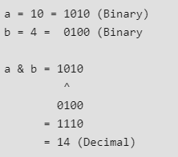
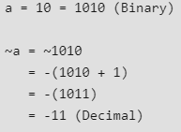
a ^ b - Returns 1 if one of the bit is 1 and other is 0 else returns 0.
~a -

Slide 26
Shift Operators – Bitwise Operators
These operators are used to shift the bits of a number left or right thereby multiplying or dividing the number by two respectively.
They can be used when we have to multiply or
divide a number by two

Slide 27
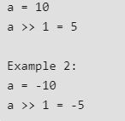
Bitwise Right Shift (x >> y) – similar effect as dividing a number with some power of 2.

Slide 28

Bitwise Left Shift (x << y) – similar effect as multiplying a number with some power of 2.

Slide 29
Task 02

Slide 30
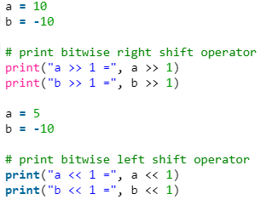
Try this code snippet…
“

Slide 31

Thanks!
ANY QUESTIONS?

